Slide 1
Promoting Program Quality through Reflective Processes
Karen Shores – CA Department of Education
Mike Henson – National Academy Foundation
Beth Kay – National Academy Foundation
Arlene LaPlante – ConnectEd: The California
Center for College and Career
Notes:
Ready for College and Career: Creating Multiple Pathways in California's High Schools
ConnectEd: The California Center for College and Career (www.ConnectEdCalifornia.org)
1

Slide 2
Welcome and Introductions
Introductions
Outcome - to understand how to move from self- assessment and reflection to program improvement

Slide 3
Why self-assessment and certification?
What are the advantages and disadvantages of doing this work to align the quality criteria/standards/strategic actions and reflective processes?

Slide 4
CALIFORNIA PARTNERSHIP ACADEMIES
Assessment and Recognition

Slide 5
How are CPAs Evaluated?
CA Partnership Academy Annual Report (CAPAAR) – due October 15 each year.
Proposed annual budget
Communications with Academies
Site visits
New: Assessment and Recognition Tool (ART)

Slide 6
Role of CPA ART
Self-Assessment for successes, needs, compliance, and improvement
Assessment by peers (Lighthouse Academies) for feedback on accomplishments and needs
Directions for technical assistance
Recognition by the California Department of Education (CDE)

Slide 7
CPA ART in Relation to ConnectEd & NAF Certifications
Similar intent, goals and standards
Similar formats – criteria and examples of evidence
Overlap in many categories since all are based on the National Standards for Career Academies
Some criteria are specific to each model

Slide 8
Challenge
How to respect the validity of, and need for, each assessment tool as they evaluate the implementation of the specific career pathway models (CPA, ConnectEd, and NAF)
And avoid the need for schools and programs to prepare for multiple, very similar assessments

Slide 9
Solution
Collaboration
For those programs with multiple models:
Find areas of overlap and similarity and unite to one set of standards in those areas whenever possible
Find areas of differences and add section to tool for requirements unique to each model.

Slide 10
Current Solution
Include section 2 of CPA “ART” to ConnectEd Certification Tool when assessing a CA Partnership Academy.
This section addresses specific Education Code requirements for funded CPAs
Most other criteria found in the CPA ART are addressed in sections of the ConnectEd Certification Tool.
Continue to collaborate and refine

Slide 11
Thank You
California Department of Education
High School Transformation Unit
CPA Website:
http://www.cde.ca.gov/ci/gs/hs/cpagen.asp
Career Academy Support Network CPA Website,
And California Partnership Academy Assessment & Recognition Tool:
http://casn.berkeley.edu/cpa.php
Karen Shores kshores@cde.ca.gov 916-319-0478
11
Notes:
11

Slide 12
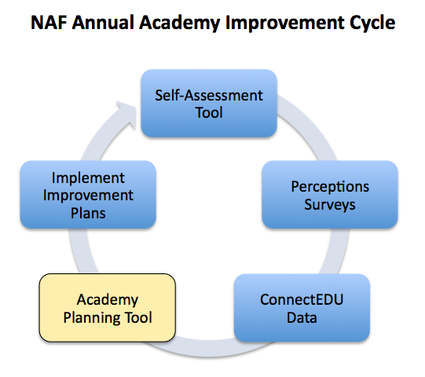
The Academy Planning Tool

Slide 13
Mike Henson, Network Services Director
mhenson@naf.org
Beth Kay, Academy Development Manager
bkay@naf.org
Cindy McHugh, Partnership Development Manager
cmchugh@naf.org
Aazam Irilian, Curriculum Specialist
airilian@naf.org
Ana Morrison, Network Liaison
amorrison@naf.org

Slide 14
lllllllllllllllllllllllWhy Certifiction of Pathway Quality?
To achieve desired results
To guide sites in planning and implementing pathways
To use the Quality Criteria to meet stakeholders’ needs:
For pathway team members - a guide to build, improve, and sustain high-quality pathways
For others - a way to deepen understanding by describing the elements of a high-quality pathway.
Notes:
educational leaders, industry and postsecondary partners, policymakers, and community members

Slide 15
Cr C Developing the Process and the Tools
Formation of Design Tea
Designing process and creating tools
Field Test
Pilot
Notes:
educational leaders, industry and postsecondary partners, policymakers, and community members

Slide 16
Llllllllllllllllllllll l Why Self-Assessment of Pathway Quality?
Rubric for Linked Learning Pathway Certification – a tool for pathway teams to use for. . .
Visioning—gain a common understanding of
what a high-quality pathway looks like;
Self-assessment—analyze the current status and
quality of each element of the pathway;
Planning –identify and set priorities for areas of
improvement from which to develop annual
action plans;
Quality review – external reviewers can assess
and validate program quality.
Notes:
educational leaders, industry and postsecondary partners, policymakers, and community members

Slide 17
Pathway Certification Process
Self-assessment
Collection and review of evidence
Reflective narratives
Data collection
Site visit
Final Report
Action Plan

Slide 18
Pathway Certification Process
Possible outcomes
Certified
Model
In Progress

Slide 19
Look at the 3 sets of criteria/standards (CPA/NAF/Linked Learning):
Determine where they do/don’t align.
Determine what you would need to do to bring them to alignment.
Be specific. What would the aligned standards/criteria look like? If a standard/criteria can’t be aligned, how would you proceed to create one certification process that will work for all?

Slide 20
Break

Slide 21
Case Study

Slide 22
Creating the Plan of Action
Review the Final Report and develop a plan of action for pathway improvement.

Slide 23
Academy Planning Tool
STRENGTH AREAS (Discuss one high-scoring standard from your Academy’s Self-Assessment Tool results)
NAF Model Alignment | What is Working | Why it’s Working | Implications for Priority Improvement Areas
Academy Develop.  Advisory Board Curriculum Work-Based Learn. Related Standard: 2.2 Support for Learning | Our Advisory Board does a great job of helping teachers with project planning, providing guest speakers for classes, and providing WBL experiences. | AB is large, engaged, and has a dynamic leader. AB members have developed good relationships with Academy staff and students. Once AB members started working with students directly, they were “hooked” and wanted more! | Leadership matters—we need someone to spearhead our tutoring issue. Investing in building solid, productive relationships with partners can help with needs in many areas of our program, including student support. Small successes lead to big successes later down the line. Just as the AB members have grow in their involvement over time, our volunteer tutors may need to start with low levels of commitment and involvement and grow in their comfort and capacity over time.
Academy Develop. Advisory Board Curriculum Work-Based Learn. Related Standard:

Slide 24
PRIORITY IMPROVEMENT AREAS (Select two low-scoring standards from your Academy’s Self-Assessment Tool results; at least one from the Curriculum section)
Model Alignment | Goal | Actions Steps | Leader | Resources (have/need) | Deadlines | Evidence of Success
Academy Develop. Advisory Board  Curriculum Work-Based Learn. Related Standard: 3.3 Instructional Supports | Design and implement a tutoring program to help struggling Academy students improve their grades | 1. Assess the need for tutoring – how many students, which subjects, how often 2. Recruit and train tutors from employer partner volunteers and upperclassmen 3. Establish location, schedule, and policies 4. Advertise tutoring center/invite students 5. Conduct evaluation after 3 weeks | Pat - lead steps 1 & 5 Jo – lead steps 2-4 | Have… Names of 4 volunteers who might be willing to serve as tutors or help recruit others Need… 5-10 trained tutors Someone to lead training | Assess need by 9/13 Train tutors by 9/29 Launch by 10/4 | Tutoring program is operating by 10/4 Struggling students participating in tutoring program show improvement in their Academy course grades
Academy Develop. Advisory Board Curriculum Work-Based Learn. Related NAF Standard:

Slide 25
How Good is Good Enough?
Group discussion – How good is good enough? and How will you know it?

Slide 26
Karen Shores
kshores@cde.ca.gov
Mike Henson
mhenson@naf.org
Beth Kay
bkay@naf.org
Arlene LaPlante
alaplante@connectedcalifornia.org

Slide 27
Next steps
And . . .
EVALUATION FORMS

